Slide 1
Foundations of group behaviour

Slide 2
Defining & classifying groups
A group is a collection of two or more people who work with one another regularly to achieve common goals.

Slide 3
Formal groups.
  Officially designated to serve a specific organizational purpose.
  May be permanent or temporary.
    Permanent work groups are command groups in the vertical organization structure.
    Temporary work groups are task groups specifically created to solve a problem or perform a defined task.

Slide 4
Formal groups — cont.
  Virtual groups.
    Groups whose members convene and work together electronically via networked computers.
    Activities are facilitated by groupware.
    Can accomplish the same things as members of face-to-face groups.

Slide 5
Informal groups.
  Emerge without being officially designated by the organization.
  appear in response to need for social contact
  Types of informal groups.
    Friendship groups.
    Interest groups. (common objective)‏

Slide 6
Benefits of informal groups.
  Can speed up work flow by supplementing formal lines of authority.
  Can satisfy needs that are thwarted or unmet by the formal group.
  Can provide members with social satisfaction, security, and a sense of belonging.

Slide 7
Why people join groups
Security (not alone)‏
Status (recognition)‏
Self esteem (self worth)‏
Affiliation (fulfilling social needs)‏
Power (strength in numbers)‏
Goal achievement (pool of talent, knowledge, power)‏
Working in groups requires a certain amount of trust.

Slide 8
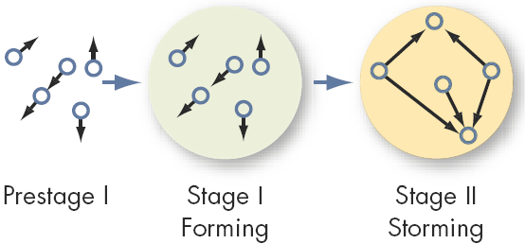
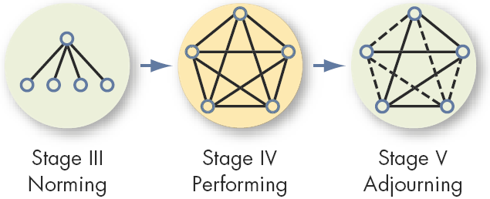
What are the stages of group development?
A group or team passes through five life-cycle stages.
  Forming.
  Storming.
  Norming.
  Performing.
  Adjourning.

Slide 9
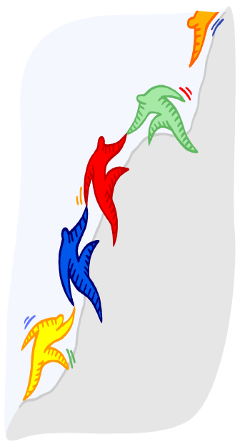
Stages of group development?
Forming stage.
  Initial entry of members to a group.
  Great deal of uncertainty
  Members concerns include:
    Getting to know each other.
    Discovering what is considered acceptable behaviour.
    Determining the group’s real task.
    Uncertainty about leadership in the group
    Defining group rules.
    This stage is complete when members begin to think of themselves as members of a group

Slide 10
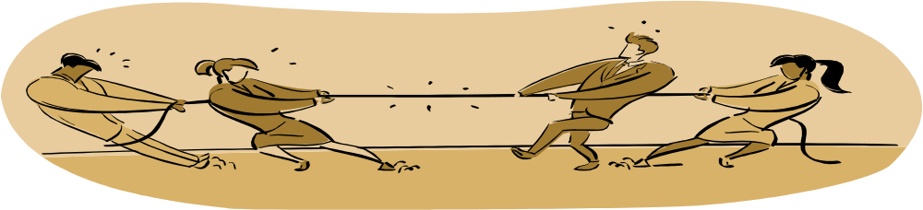
Stages of group development
Storming stage.
  stage of intra-group conflict – members resist the constraints that the group imposes on individuals
  A period of high emotions and tension among group members.
  Members concerns include:
    Formation of coalitions.
    Clarifying membership expectations.
    Who will control the group?
    Dealing with obstacles to group goals.
    Understanding members’ interpersonal styles.

Slide 11

Stages of group development
Norming stage.
  The point at which the group really begins to come together as a coordinated unit.
  strong sense of group identity and camaraderie
  Members concerns include:
    Holding the group together.
    Dealing with divergent views and criticisms.
    Dealing with a premature sense of accomplishment.

Slide 12
Stages of group development
Performing stage.
  Marks the emergence of a mature, organized, and well-functioning group.
  Group energy has moved from getting to know and understand each other to performing the task at hand
  Members deal with complex tasks and handle internal disagreements in creative ways.
  Primary challenge is to continue to improve relationships and performance.
Performing is the last stage for permanent groups

Slide 13
Stages of group development
Adjourning stage.
  Particularly for temporary groups.
  A well-integrated group is:
    Able to disband when its work is finished.
    Willing to work together in the future.
  Reactions of members:
    glad and reflect on achievements
    sad at loss of camaraderie and relationships

Slide 14
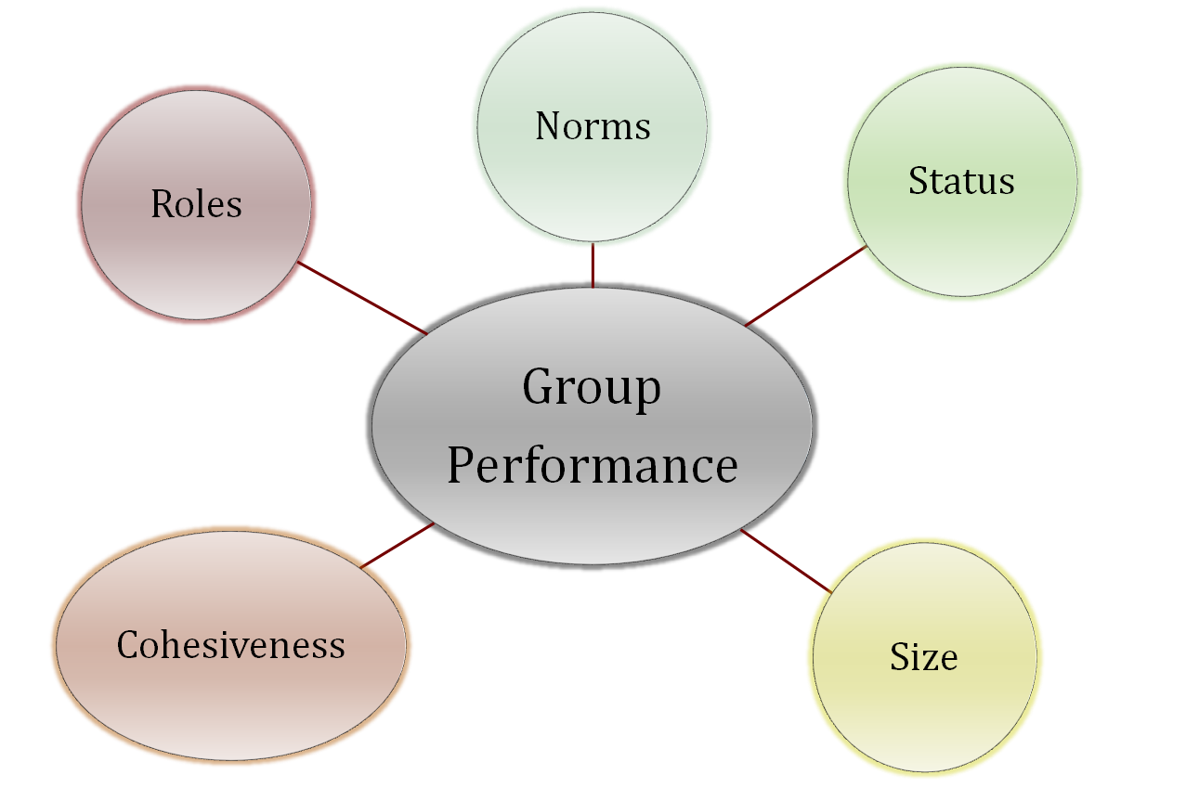
Group Properties/characteristics
Work groups have properties that shape the behaviour of members and make it possible to explain and predict a large part of individual behaviour within groups as well as the performance of the group itself.

Slide 15
Roles
we play different roles in differing environments
role identity : attitude and behaviour to match a role/ consistent with a role (e.g. promotion, anti vrs pro)‏
role perception : how are we supposed to act in a given situation (where do we get these perceptions? - various stimuli - movies, friends, TV, etc)‏
role expectations :how others believe you should behave in a given situation (aggressive, integrity, dynamic, etc.)‏
role conflict: when individual is confronted by divergent role expectation

Slide 16
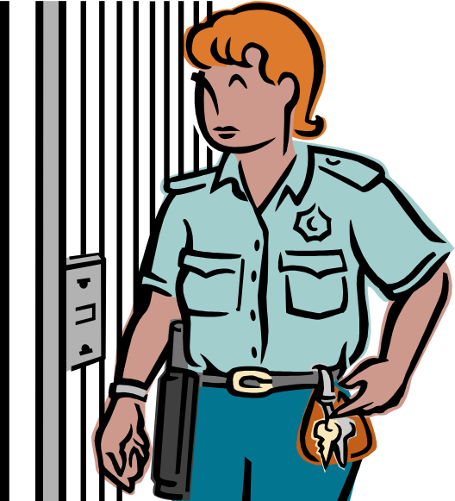
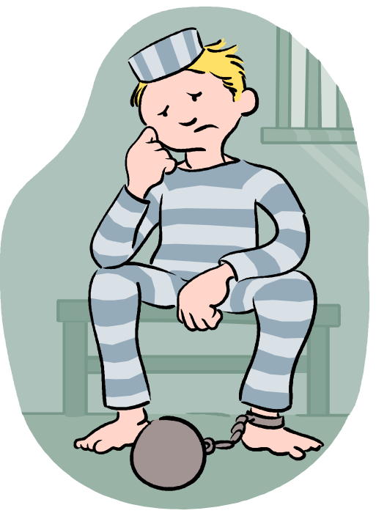
Zimbardo’s Prison Experiment
Faked a prison using student volunteers
Randomly assigned to guard and prisoner roles
Within six days the experiment was halted due to concerns
  Guards had dehumanized the prisoners
  Prisoners were subservient
  Fell into the roles as they understood them
  No real resistance felt
Proved how quickly individuals learn their roles

Slide 17
Norms
acceptable standards of behaviour shared by group members
Norms tell members what they ought and ought not to do in certain circumstances
When agreed to and accepted to by a group, it influences behaviour of group members without external controls
Desire for acceptance leads to conforming to group norms
x
a b c

Slide 18
Status
Socially defined position/rank given to group or group members by others
Status is a significant motivator
Status normally comes from
  Power an individual has over others
  A person’s ability to contribute to group goals
  Individual’s personal characteristics
High status members may be given more freedom to deviate from group norms
High status members may be more assertive which may inhibit group interactions
Members must believe that status hierarchy is equitable to ensure equilibrium in the group.
Cultural differences also affect status (french, british, japanese, american) = which may lessen personal effectiveness.

Slide 19
Size
The size of a group affects overall group behaviour
Smaller groups complete tasks faster and individuals perform better in smaller groups
Large groups better in gaining more input and small groups in evaluating the input.
Social loafing is related to group size.

Slide 20
Social loafing as a performance problem.
  Social loafing is the tendency of people to work less harder in a group than they would individually.
  Reasons for social loafing.
    Individual contributions are less noticeable in the group context.
    Some individuals prefer to see others carry the workload.

Slide 21
Social loafing as a performance problem — cont.
  Ways of preventing social loafing.
    Define member roles and tasks to maximize individual interests.
    Link individual rewards to performance contributions to the group.
    Raise accountability by identifying individuals’ performance contributions to the group.

Slide 22
Cohesiveness
Groups differ in their cohesiveness, i.e. the degree to which group members are attracted to each other and are motivated to stay in the group.
Cohesiveness may come through
  Length of time members have been together
  Size of the group
  Group faces external threat
Cohesiveness can be encouraged by:
  Making the group smaller
  Agreeing to common group goals
  Increase the time members spend together
  Increase status of the group
  Stimulate inter-group competition
  Physically isolate the group
  Reward the group rather than individual members

Slide 23
Strengths & Weaknesses of
Group Decision Making
Strengths
  Generates more complete information and knowledge
  Offers greater diversity of views/opinions
  Leads to greater acceptance of decisions/ solutions
Weaknesses
  More time consuming
  Pressure to conform in groups
  Group may be dominated by one/few group members
  Ambiguous responsibility

Slide 24
Effectiveness & efficiency
Attribute
Small
Large
Speed
X
Individual Performance
X
Problem Solving
X
Diverse Input
X
Fact-finding Goals
X
Overall Performance
X
Accuracy
X
How groups make decisions.
  Decision by lack of response.
  Decision by authority rule.
  Decision by majority rule.
  Decision by consensus.

Slide 25
Groupthink…is related to norms
Describes situations where group pressures deter critical appraisals, minority or unpopular views.
When a group pressures for conformity, there is a tendency for members of highly cohesive groups to lose their critical evaluation capabilities.
  End Result = Groupthink can lead the group towards making poor decisions.

Slide 26
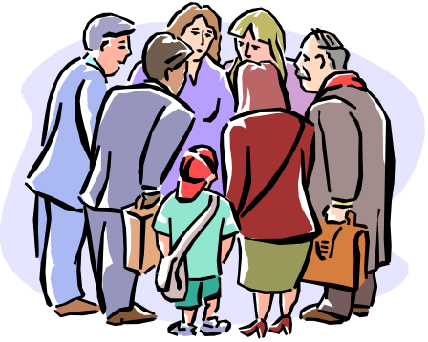
Groupthink
Symptoms:
  Group members rationalize any resistance to the assumptions they have made
  Members apply direct pressures on those who express doubts about shared views or who question the alternative favoured by the majority
  Members who have doubts or differing points of view keep silent about misgivings or downplay the importance of their doubts
  There appears to be an illusion of unanimity : abstention is viewed as a ‘Yes’ vote.
Minimize Groupthink by:
  Reduce the size of the group to 10 or less
  Encourage group leaders to be impartial
  Appoint a “devil’s advocate”
  Use exercises that stimulates active discussion of various alternatives and their potential dangers /risks

Slide 27
Groupshift
  There are differences between group and individual decision making.
  In some cases, the group decision is more cautious than individual. In most cases, the shift is towards greater risk.
  What happens to members during group discussion – conservatives and risk takers become more extreme in their choices. Why?
  Most shifts have been on the Risky Side....
      Familiarity in group makes a person more bold
      Some societies value risk in individuals
      Responsibility is spread out in the group

Slide 28
How do groups make decisions?
How to improve group decision making.
  Brainstorming.
  Nominal group technique.
  Delphi technique.
  Computer-mediated decision making.

Slide 29
How do groups make decisions?
Brainstorming (about 6 persons)‏
  Group members actively generate as many ideas and alternatives as possible, and they do so relatively quickly and without inhibitions.
  Brainstorming rules.
    All criticism is ruled out.
    Free-wheeling is welcomed.

Slide 30
How do groups make decisions?
Nominal group technique.
  Restricts discussion or inter personal communication during the decision making process.
  Groups members are physically present – problem is presented and then:
    Each member writes down ideas before meeting as a group
    Turn by turn, members present ideas to the group
    Then group discuss all ideas for clarity
    Each member ranks order the ideas silently
    Ideas with the highest aggregate ranking determines final decision

Slide 31
How do groups make decisions?
Delphi technique.
  Used in situations where group members are unable to meet face to face.
  The process.
    A series of questions is distributed to a panel.
    Panel members submit their responses to a decision coordinator.
    The decision coordinator summarizes the responses, and sends the summary along with a follow-up questionnaire to the panel.
    Panel members send in their responses.
    The process is repeated until a consensus is reached.

Slide 32
How do groups make decisions?
Computer-mediated decision making.
  Electronic brainstorming through the use of special software and personal computers..
  The nominal group and Delphi techniques lend themselves to computer mediation.
  Issues are presented and participants type their responses which are displayed onto the larger screen
  Advantages: Anonymity, honesty, speed

Slide 33
Characteristics of
Effective Teams
Clear goals.
Relevant skills.
Mutual trust.
Unified commitment.
Good communication.
Negotiating skills.
Appropriate leadership.
Internal and external support.

Slide 34
To Build Trust
Communicate openly.
Support team member’s ideas.
Be respectful.
Be fair.
Be predictable.
Demonstrate competence.

